Slide 1
File Handling

Slide 2
Python too supports file handling and allows users to handle files i.e., to read and write files, along with many other file handling options, to operate on files. The concept of file handling has stretched over various other languages, but the implementation is either complicated or lengthy, but like other concepts of Python, this concept here is also easy and short. Python treats files differently as text or binary and this is important. Each line of code includes a sequence of characters and they form a text file. Each line of a file is terminated with a special character, called the EOL or End of Line characters like comma {,} or newline character. It ends the current line and tells the interpreter a new one has begun. Let’s start with the reading and writing files.

Slide 3
r
Opens a file for reading only. The file pointer is placed at the beginning of the file. This is the default mode.
rb
Opens a file for reading only in binary format. The file pointer is placed at the beginning of the file. This is the default mode.
r+
Opens a file for both reading and writing. The file pointer placed at the beginning of the file.
rb+
Opens a file for both reading and writing in binary format. The file pointer placed at the beginning of the file.
w
Opens a file for writing only. Overwrites the file if the file exists. If the file does not exist, creates a new file for writing.
wb
Opens a file for writing only in binary format. Overwrites the file if the file exists. If the file does not exist, creates a new file for writing.

Slide 4
S.No.
Mode & Description
7
w+
Opens a file for both writing and reading. Overwrites the existing file if the file exists. If the file does not exist, creates a new file for reading and writing.
8
wb+
Opens a file for both writing and reading in binary format. Overwrites the existing file if the file exists. If the file does not exist, creates a new file for reading and writing.
9
a
Opens a file for appending. The file pointer is at the end of the file if the file exists. That is, the file is in the append mode. If the file does not exist, it creates a new file for writing.
10
ab
Opens a file for appending in binary format. The file pointer is at the end of the file if the file exists. That is, the file is in the append mode. If the file does not exist, it creates a new file for writing.
11
a+
Opens a file for both appending and reading. The file pointer is at the end of the file if the file exists. The file opens in the append mode. If the file does not exist, it creates a new file for reading and writing.
12
ab+
Opens a file for both appending and reading in binary format. The file pointer is at the end of the file if the file exists. The file opens in the append mode. If the file does not exist, it creates a new file for reading and writing.

Slide 5
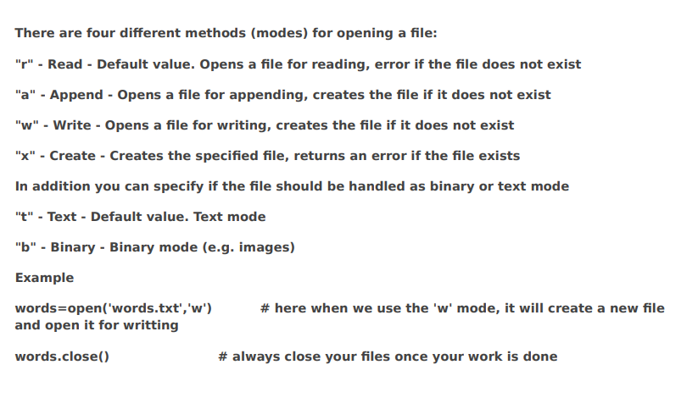

Slide 6
writing to a file
once you open a file in python, there are 2 ways to write to a file. You can open the file in one of the following modes to get the desired result "a" - Append - will append to the end of the file "w"- Write - will overwrite any existing content Then, to write to the file, simply use the .write() method. # Python code to create a file
file = open('geek.txt','w')
file.write("This is the write command")
file.write("It allows us to write in a particular file")
file.close()
Working of append() mode
# Python code to illustrate append() mode
file = open('geek.txt', 'a')
file.write("This will add this line")
file.close()

Slide 7
READING FILES:
File can be read using three methods namely read( ), readline( ) and readlines( ).
read( ) - Returns the entire file content (Previous Example)
readline( ) - Reads a single line from a file at a time.
readlines( ) - The readlines() method returns a list of lines from the file.

Slide 9
Working of read() mode
# a file named "geek", will be opened with the reading mode.
file = open('geek.txt', 'r')
# This will print every line one by one in the file
for each in file:
print (each)
# Python code to illustrate read() mode
file = open("file.txt", "r")
print (file.read())
# Python code to illustrate read() mode character wise
file = open("file.txt", "r")
print (file.read(5))

Slide 10
Used for reading a file line by line.
By default, this method reads the first line in the file.
For example, if we are reading the first five lines from a text file, run a loop five times, and use the readline() method in the loop’s body. Using this, we can read a specific number of lines.
Example:
with open('geek.txt', 'r') as fp:
line = fp.readline()
print(line)
fp.close()
Output:
First Line

Slide 11
Reads file line by line into a list.
It will return the entire file contents.
The reading of the contents will start from the beginning of the file till it reaches the EOF (End of File).
The output provided by this method is in list format.
Example:
open('read_demo.txt', 'r') as fp:
lines = fp.readlines()
print(lines)
fp.close( )
Output:
['First line\n', 'Second line\n', 'Third line\n', 'Fourth line\n', 'Fifth line']

Slide 12
We can also split lines using file handling in Python. This splits the variable when space is encountered. You can also split using any characters as we wish. Here is the code: # Python code to illustrate split() function with open("file.text", "r") as file: data = file.readlines() for line in data: word = line.split() print (word)

Slide 13
WRITING TO A FILE:
Writing contents to a file can be done using two different methods.
write() : Inserts the string str1 in a single line in the text file. File_object.write(str1)
writelines() : For a list of string elements, each string is inserted in the text file. Used to insert multiple strings at a single time. File_object.writelines(L) for L = [str1, str2, str3]
Note: ‘\n’ is treated as a special character of two bytes.

Slide 14
file1 = open('myfile.txt', 'w')
s = "Hello\n"
file1.write(s)
L = ["This is Delhi \n", "This is Paris \n", "This is London \n"]
file1.writelines(L)
file1.close()
file1 = open('myfile.txt', 'r')
print(file1.read())
file1.close()

Slide 15
APPENDING TO A FILE:
In this mode, the handle is positioned at the end of the file.
EXAMPLE: Modifying the previous saved file
file1 = open("myfile.txt", "a") # append mode
file1.write("Today \n")
file1.close()
file1 = open("myfile.txt", "r")
print("Output after append:")
print(file1.read())
print()
file1.close()
Output:
Output after append:
Hello
This is Delhi
This is Paris
This is London
Today

Slide 16
RENAMING FILES:
The rename( ) method provided by the OS module renames the file.
SYNTAX: os.rename(old_name, new_name)
EXAMPLE:
#In this example, we are renaming “detail” to “new_details”.
import os
old_name = r"E:\demos\files\reports\details.txt"
new_name = r"E:\demos\files\reports\new_details.txt"
os.rename(old_name, new_name)

Slide 17
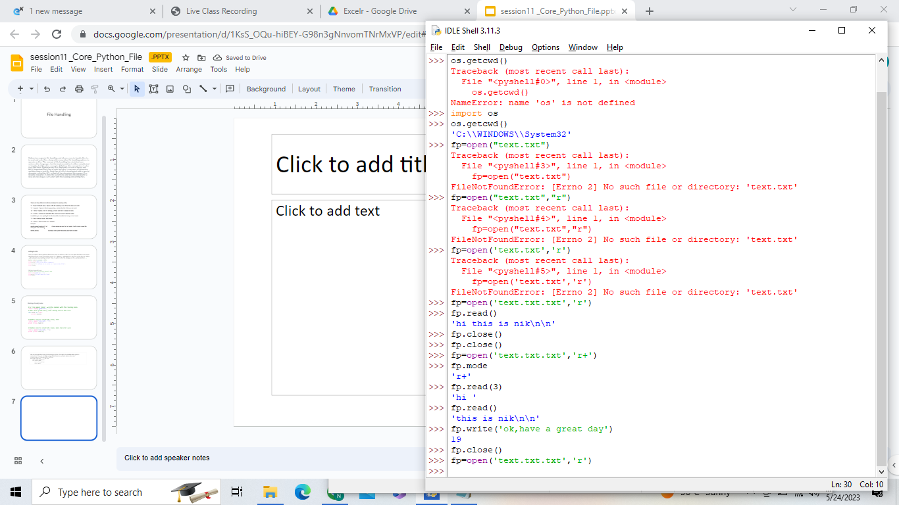

Slide 18
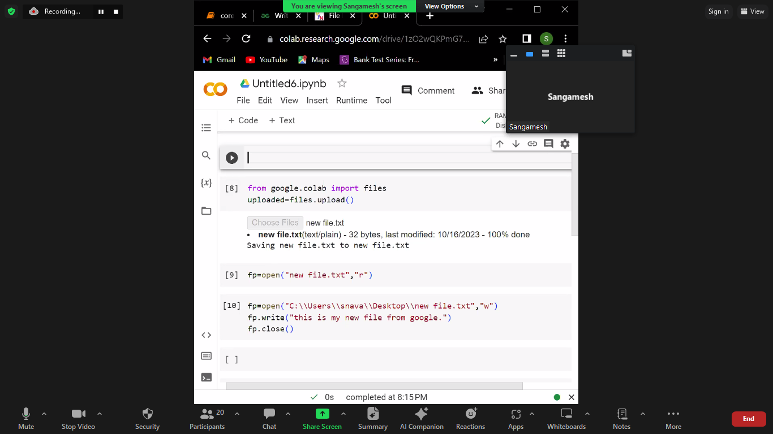

Slide 19
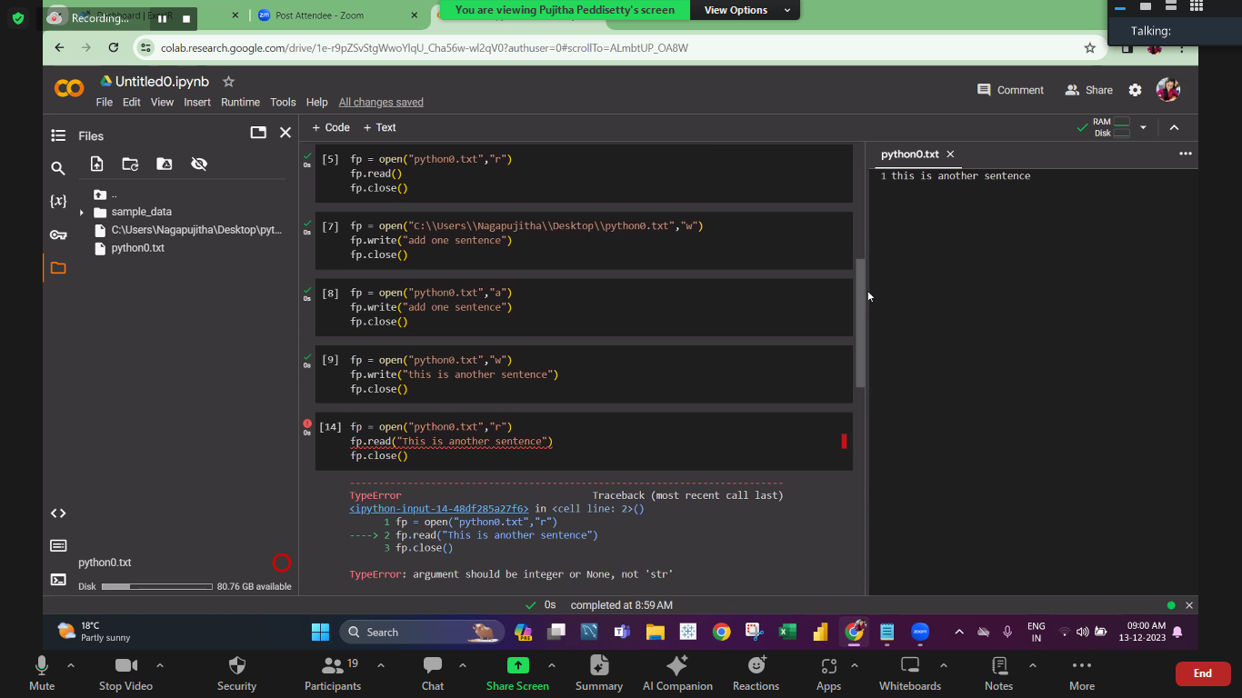

Slide 20
1. _________ is a named location on a secondary storage media where data are permanently stored.
a) Memory
b) Folder
c) File
d) Drive
2. Which of the following is data file ?
a) Text file
b) Binary file
c) Both (a) and (b)
d) None of the above

Slide 21
3. i) Computer stores every file in binary format.
ii) Both text and binary files are human readable.
a) (i) True, (ii) False
b) (i) False, (ii) True
c) Both are true
d) Both are false
4. Which of the following is not an appropriate file access mode ?
a) <a>
b) <r+>
c) <w>
d) <wr+>

Slide 22
5. Consider the following code:
fileobject = open('sample.txt", "w")
fileobject.write("HelloWorld\n")
fileobject.close()
When you execute this, what would be the output?
a) No output
b) 20
c) 21
d) Hello World

